Slide 1

By : Omar M.Hussein, Sara Ferrari, Zhihong

Slide 2
The “How Might We?”
Challenge: Improve interactive file system on Canvas
Subject: Some students felt Canvas is hard to track the group work and the file system is old and not user-friendly. We need to avoid the professors to move to other platforms. Increase the market share using new functionalities.
Small HMW: make it easier for instructor to contact the students
This How Might We for different reasons:
Communication problems between students and professors
We are interested in making it a more user friendly application.
In our team there are people interested in the User Interface.

Slide 3
Top scratch ideas
Create a Rubric generator/editor (idea1- 30/30)
Export/import All Grading Comments to/from a readable file(idea2 - 30/30)
Text-recommendation in messages.(idea3 - 30/30 )
Historical question forums about assignments and certain topics Updated Yearly(idea4 - 28/30)
improve notifications(idea5 - 28/30)
students can make groups(idea6 - 27.5/30)
connect the files with dropbox(idea7 - 27/30)

Slide 4
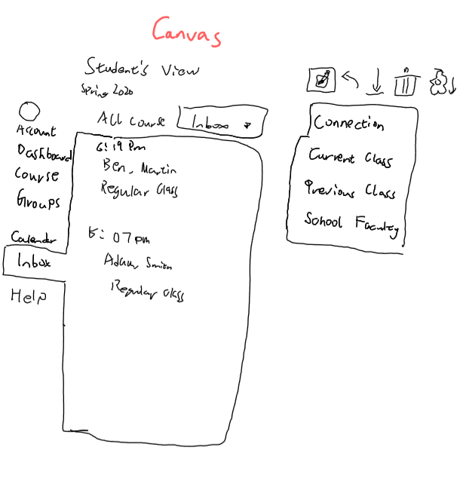
Call me by my name
Create for each account a starred contact list with the classmate, professor, TA connection and connect it to the YU mail.
KPI: The amount of contacts correctly classified as starred.
Research Google and IOs contact list and how they connect between different apps.

Slide 5
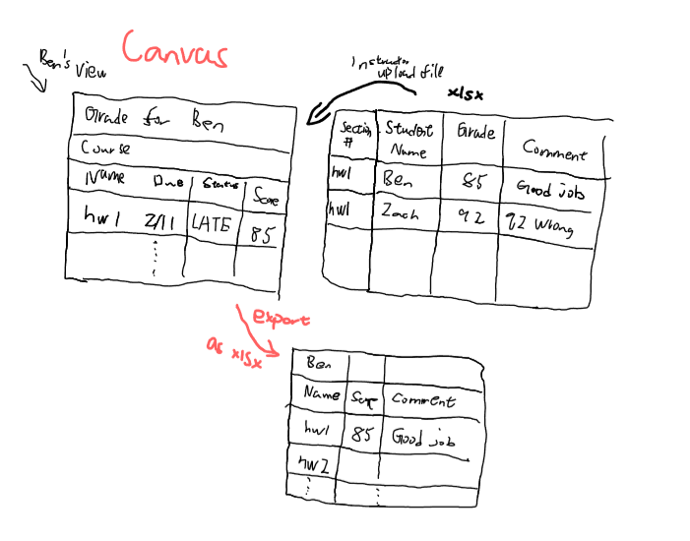
If you can write it you can read it
Professors can put the evaluations in an Excel format and submit it. This way they would avoid to do that manually for each student on Canvas.
Students can also download information locally.in an Excel format for each class and grade.
Use Python to collect and distribute the information on Canvas and vice-versa. Use personal student/professor data to match the scores.
KPI:Reducing the average time used to perform the task.

Slide 6
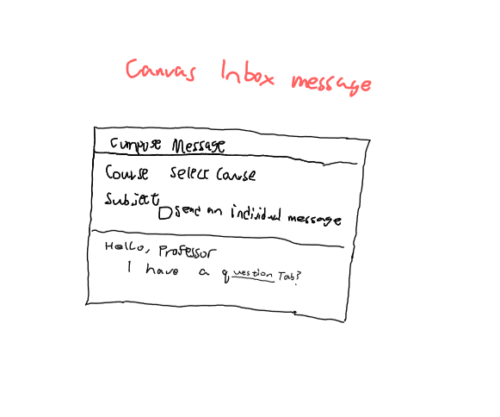
Write it right
We need to improve message function of Canvas. Since Canvas lacks of many necessary function, it is a bit inconvenient for students to send mail. We need to add text-recommendation available for academia to make communication easily.
KPI: #spelling error avoided, number of predicted words used.
JSON along with other open API can enable the function on text-suggesting

Slide 7
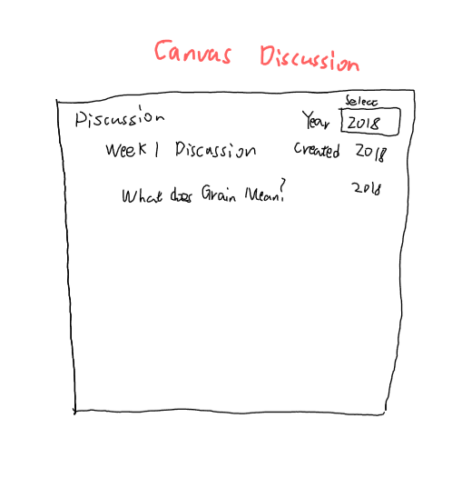
To be or not to be?
History of Question(s)
We need to improve forum function of Canvas. Generally students have the similar questions yearly and it may be a waste if we discard this data every year .We need to add historical question forum per subject available for students have this class.
KPI: The amount of visits to the forum.
Use Json to make the forum historical question available for students

Slide 8
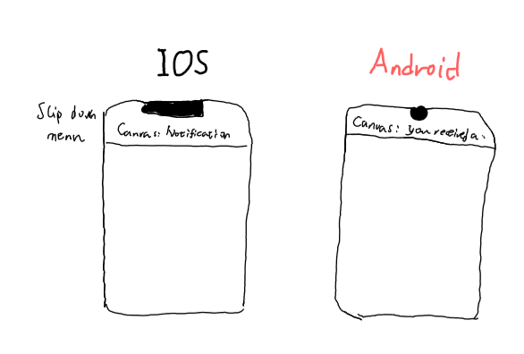
You've Got Mail
We have to improve notifications for Canvas. Using the report on email is not the most efficient way to interact on time. We need to create notifications like any other app when something that you like change or is added.
KPI: The number of people who enabled the feature.
Use Java to improve the app and create notification and settings.

Slide 9
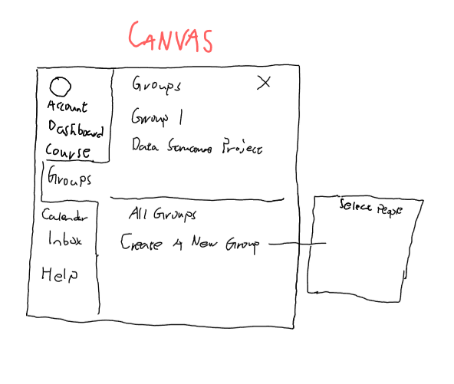
{Time to group}
We have to improve group function of Canvas.Waiting for teacher to assign is not very efficient to work on the group. We need to create groups freely like any other app(such as Whatsapp) when you want to work or discuss with some people together.
KPI: The number of groups created.
This extension of messages function can rely on either java or JSON

Slide 10
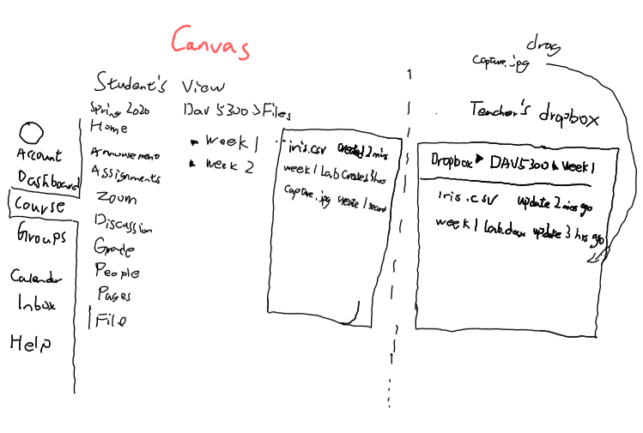
Just drop it!
We need the file sharing feature on canvas.The file navigation system on canvas would benefit greatly from integrating with a cloud based storage. Both professor and student have a personal folder for the course and they can directly upload the file there and automatically canvas will push the files in due time.
KPI: The success/failure ratio, in addition to the total number of users.
This can be used by authentication and integrated with dropbox WebDAV protocol

Slide 11
Ideas
New
Use Case
To be or not to be ?
{Time to group}
Call me by my name
Just drop it!
If you can write you can read it
Write it right
Existing
Use Case
You’ve got mail
Professor focused
Student focused

Slide 12
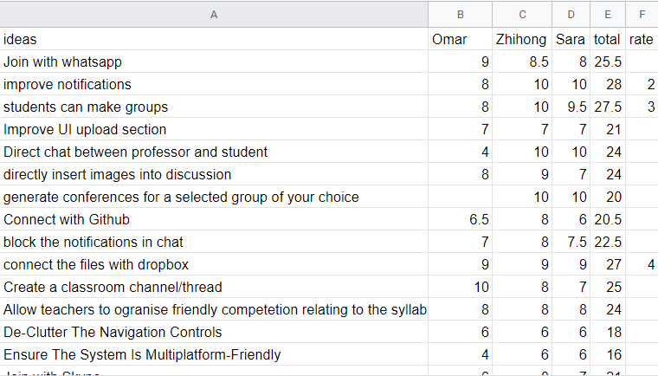
Appendix: Scratched ideas sample

